Slide 1

OSCE WORKSHOP
4TH family medicine review course
DR.LULUA FALAH ALASOUSI

Slide 2
Gastroenterology
1)Dyspepsia
2) Colon cancer screen
3) IBS

Slide 3
case1
27yrs old female come to your clinic with heart burn x 3 month
Endoscopy done: -show urea breath test +
- mild gastritis
What treatment you will give?
What advice to be given?

Slide 4
Dyspepsia
R reassurance
Explain dyspepsia or indigestion symptom that occur when there is problem in digestion in the upper gut.
A advice:
Diet (trigger associated with dyspepsia) eig chocolate , coffee, tomatoes and fatty or spicy food
main meal > 3 hr. before bed time and raise the head of the bed 10-20cm
Smoking cessation and weight loss
Avoidance of known precipitant of their dyspepsia –reduce alcohol if > 14unit\week
Increase physical activity to more or equal to 150min\week

Slide 5
P prescription- undiagnosed dyspepsia:
Trail of full dose PPI for 1 month( omeprazole 20mg od) OR test and treat approach for H.pylori
if no response → test (urea breath test, stool antigen test, serology)
Before the test: stop antimicrobial 4 weeks prior and PPI or H2 receptor antagonist 2 weeks prior.
H. Pylori eradication:
Omeprazole 20mg bid + amoxicillin 1g bid + clarithromycin 500mg bid for 10 days.
Omeprazole 20mg bid + metronidazole 400mg bid + clarithromycin 250mg bd for 10 days

Slide 6
R referral:
immediate referral
Acute GI bleeding
urgent(within 2 week for endoscopy)
1. dysphagia
2.Upper abdominal mass consistent with stomach cancer
3. Patient ≥ 55yrs who have weight loss AND any of the following :
Reflux
Upper abdominal pain
Dyspepsia

Slide 7
Non urgent:
1.Haematemesis
2.Patient age≥55yr who have got:
-Treatment resistant dyspepsia or
Upper abdominal pain with low hb or
Raised platelets count with any of the following: nausa,vomiting ,weight loss, reflux ,dyspepsia ,upper abdominal pain
Nausea or vomiting with any of the following: weight loss, reflux, dyspepsia , upper abdominal pain

Slide 8
O follow up
Follow up after 4-6 week

Slide 9
Colon cancer screening program
A screening program to be done for any patient above 45 year old, if normal repeat after 10 years.
Its for patients with no lower GI symptoms.
The examination is a colonoscopy (a camera that will be inserted through the anus while you are sedated to look for any abnormality e.g. polyps).
The advantages is that the doctor can see and remove any polyp if found at the same time and send it to histopathology.
If there is any abnormality you will be informed and follow with the gastroenterologist, otherwise if it is normal you can repeat the test after 10 years.
You need bowel preparation (golytly or picolax laxative).
Paper of instruction about bowel preparation will be given to you with the request.
We would like to see the results of your colonoscopy later on.

Slide 10
IBS
Criteria for diagnosis
1. Symptoms >/= 6 months
Abdominal pain (relieved by defecation and increase with food) and/or
Bloating and/or
Change in bowel habits (alternating constipation and loose stool).
2. 2 of the 4 following:
Altered stool passage (straining, urgency, incomplete evacuation)
Bloating (more in women), distension, hardness or tension → Worse by eating.
Passage of mucus.
3. May have (lethargy, nausea, backache, bladder symptoms)→ support the diagnosis

Slide 11
management :
R reassurance: benign disease, can be controlled
A advice:
diet:
regular meals and take time to eat.
Do not make long gap between two meal or missing meal
3. Drink > 8 cups of fluids (water), restrict tea and coffee to 3 cups/d, decrease alcohol and fizzy drinks.

Slide 12
4.Limit intake of
high fiber or wholemeal bread and flour.
High bran cereal
Wholegrain eig brown rice
5. Limit fresh fruits to 3/d.
6. For diarrhea avoid sorbitol
7. For wind and bloating increase oats and linseeds.
8. Exclude food that increases your symptoms.
9. Limit resistant starch found in processed food

Slide 13
Low FODMAP DIET:( fermtable oligo,di,mono,scarride and polyols):
Short chain carbohydrate ---- that cause bloating and diarrhea
Food that high FODMAP eig onion, wheat ,beans and garlic

Slide 14
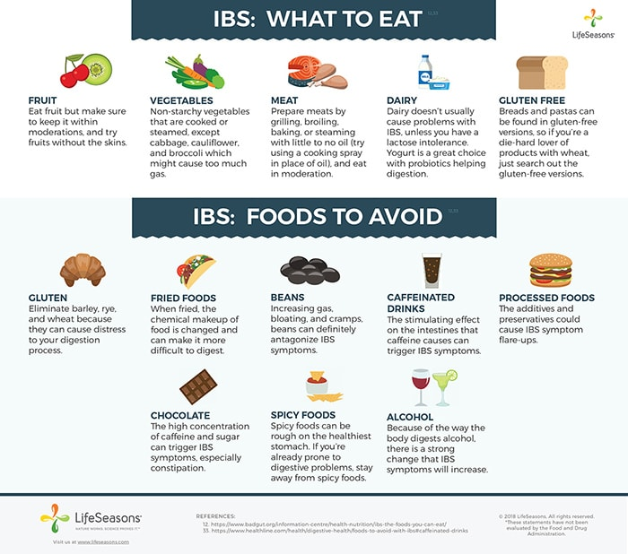

Slide 15
P prescription:
1. constipation: Fiber/bulking agents (constipation predominant) Ispaghula, laxatives an alternative but avoid lactulose.
- linaclotide( if no response)
2. pain: antispasmodics (mebeverine, hyoscine butybromide and peppermint oil).
3. Diarrhoea :loperamide
4. 2nd line: Antidepressants, amitriptyline 10 mg od, SSRI less effective. (withdraw if no response after 4-6 weeks).
5. Psychotherapy and hypnosis.

Slide 16
R referral:
unintentional and unexplained weight loss
rectal bleeding
A family history of bowel or ovarian cancer
change in the bowel habit to looser and/or more frequent stools persisting for more than 6 weeks in person over 60yrs
anemia
abdominal masses
inflammatory markers for inflammatory bowel disease

Slide 17
I investigation:
CBC, ESR, CRP, Celiac screen tissue transglutaminase(TTG)
Faceal calprotectin
Not required →U/S ,barium study, colonoscopy,TFT, stool microscopy and culture and faecal occult blood
O follow up:
Open follow up

Slide 18
Cardiovascular system
Hypertension
Newly diagnosed.
Follow up.
Came with 2 high readings and you want to confirm.
2. Hyperlipidemia

Slide 19
Case 2:
56 yrs. old patient came to your clinic with 1 week reading of his BP
his Mean BP > 150/90 (blood pressure reading done at home for 1 week)
How can you mange this patient

Slide 20
Newly diagnosed Hypertensive patient
You may have to break the news (Diagnosis)
Ask about the patient knowledge, life style, diet

Slide 21
Causes of Secondary Hypertension
Common causes
Renal parenchymal disease
Renovascular disease
Primary aldosteronism
Obstructive sleep apnea
Drug or alcohol induced
Uncommon causes
Pheochromocytoma/paraganglioma
Cushing’s syndrome
Hypothyroidism
Hyperthyroidism
Aortic coarctation (undiagnosed or repaired)
Primary hyperparathyroidism
Congenital adrenal hyperplasia
Mineralocorticoid excess syndromes other than primary aldosteronism
Acromegaly

Slide 22
Management :
R reassurance (definition)
When your heart beats, it pumps blood round your body to give it the energy and oxygen it needs. As the blood moves, it pushes against the sides of the blood vessels. The strength of this pushing is your blood pressure.
A advice :
a. Low salt diet( 3g\day), lose weight ,stop smoking, less alcohol, exercise more and reduce caffeine
b. balanced diet rich in fruit and vegetable

Slide 23
P prescription
depends on the age what to start
R referral
consider dietician, ophthalmology
I investigations
RFT, LFT, Lipid profile, urine microalbumin or albumin-creatinin ration
O observation
follow up after 2 weeks to re measure BP and see response to treatment

Slide 24
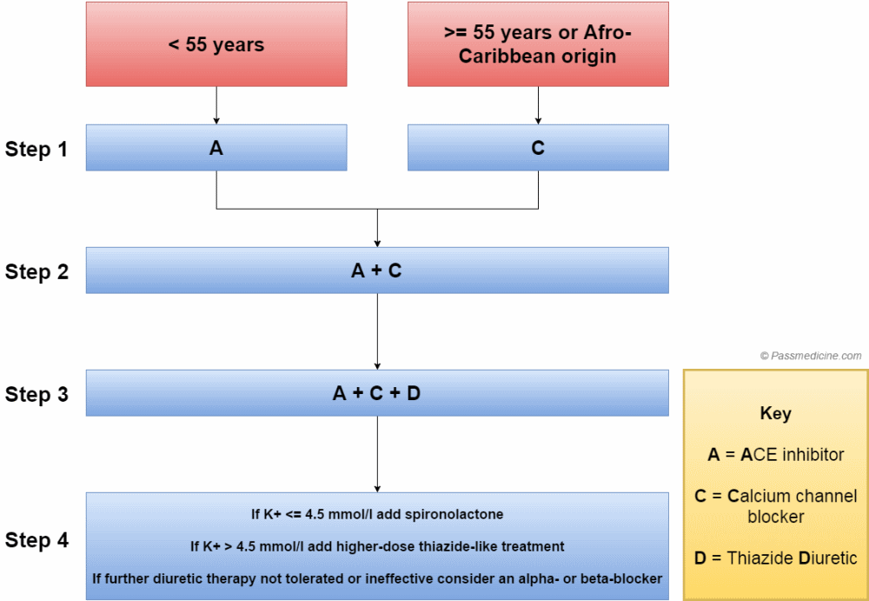
Nice guideline hypertension

Slide 25
HBPM | Clinic reading | Stage
135/85 mmHg | 140/90 mmHg | Stage I
150/95 mmHg | 160/100 mmHg | Stage II
 | 180/110 mmHg | Severe

Slide 26

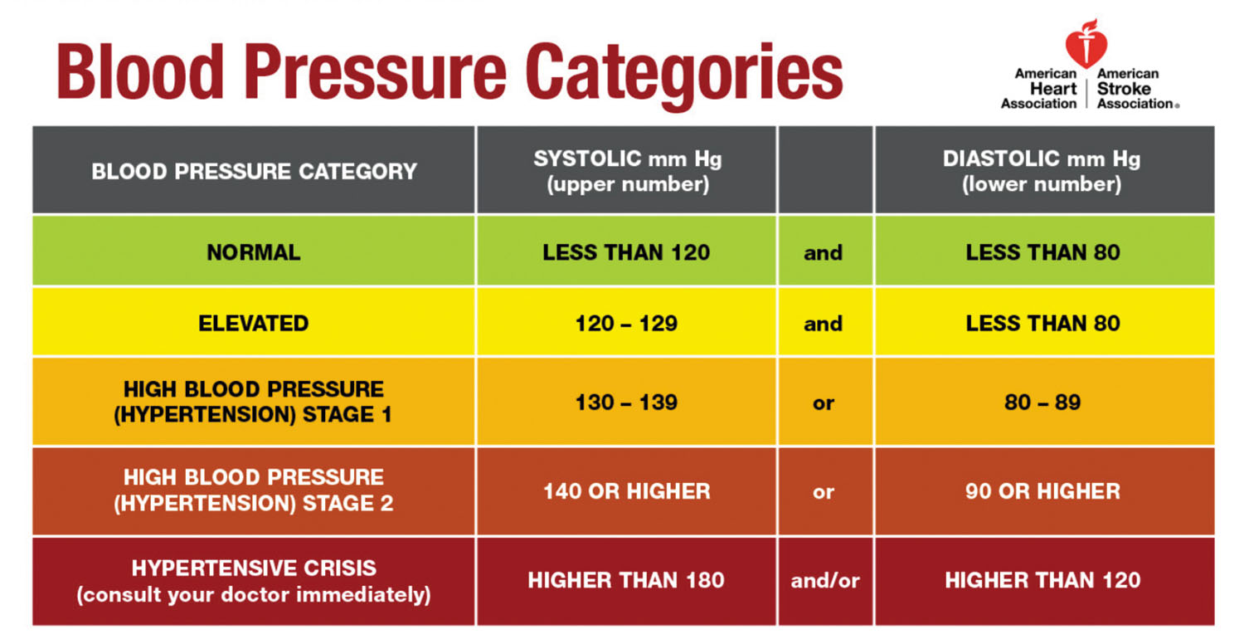

Slide 27
Hypertension guideline American heart association 2017
Management:
R reassurance:
A advice:
-DASH diet,
rich in fruits, vegetables, whole grains, and low-fat dairy products,
reducing sodium intake and increasing potassium intake to reduce BP. more information.
Weight loss- about a 1 mm Hg BP reduction for every 1 kg reduction in body weight
physical activity include 90 to 150 minutes of aerobic and /or dynamic resistance per week and/or 3 sessions per week of isometric resistance exercises.

Slide 28
 | Nonpharmacologi-cal Intervention | Dose | Approximate Impact on SBP
 |  |  | Hypertension | Normotension
Weight loss | Weight/body fat | Best goal is ideal body weight, but aim for at least a 1-kg reduction in body weight for most adults who are overweight. Expect about 1 mm Hg for every 1-kg reduction in body weight. | -5 mm Hg | -2/3 mm Hg
Healthy diet | DASH dietary pattern | Consume a diet rich in fruits, vegetables, whole grains, and low-fat dairy products, with reduced content of saturated and total fat. | -11 mm Hg | -3 mm Hg
Reduced intake of dietary sodium | Dietary sodium | Optimal goal is <1500 mg/d, but aim for at least a 1000-mg/d reduction in most adults. | -5/6 mm Hg | -2/3 mm Hg
Enhanced intake of dietary potassium | Dietary potassium | Aim for 3500–5000 mg/d, preferably by consumption of a diet rich in potassium. | -4/5 mm Hg | -2 mm Hg

Slide 29
 | Nonpharmacological Intervention | Dose | Approximate Impact on SBP
 |  |  | Hypertension | Normotension
Physical activity | Aerobic | ● 90–150 min/wk ● 65%–75% heart rate reserve | -5/8 mm Hg | -2/4 mm Hg
 | Dynamic resistance | ● 90–150 min/wk ● 50%–80% 1 rep maximum ● 6 exercises, 3 sets/exercise, 10 repetitions/set | -4 mm Hg | -2 mm Hg
 | Isometric resistance | ● 4 × 2 min (hand grip), 1 min rest between exercises, 30%–40% maximum voluntary contraction, 3 sessions/wk ● 8–10 wk | -5 mm Hg | -4 mm Hg
Moderation in alcohol intake | Alcohol consumption | In individuals who drink alcohol, reduce alcohol† to: ● Men: ≤2 drinks daily ● Women: ≤1 drink daily | -4 mm Hg | -3 mm

Slide 30
For patients who drink alcohol, aim for reducing their intake to 2 or fewer drinks daily for men and no more than 1 drink daily for women.
P Prescription:
First line:
Thiazide diuretics
Calcium channel blockers
Angiotensin-converting enzyme (ACE)
inhibitors or angiotensin-receptor blockers (ARBs)

Slide 32
Colors correspond to Class of Recommendation in Table 1.
*Using the ACC/AHA Pooled Cohort Equations. Note that patients with DM or CKD are automatically placed in the high-risk category. For initiation of RAS inhibitor or diuretic therapy, assess blood tests for electrolytes and renal function 2 to 4 weeks after initiating therapy.
†Consider initiation of pharmacological therapy for stage 2 hypertension with 2 antihypertensive agents of different classes. Patients with stage 2 hypertension and BP ≥160/100 mm Hg should be promptly treated, carefully monitored, and subject to upward medication dose adjustment as necessary to control BP. Reassessment includes BP measurement, detection of orthostatic hypotension in selected patients (e.g., older or with postural symptoms), identification of white coat hypertension or a white coat effect, documentation of adherence, monitoring of the response to therapy, reinforcement of the importance of adherence, reinforcement of the importance of treatment, and assistance with treatment to achieve BP target.

Slide 33
R referral:
consider dietician, ophthalmology
I investigation:
-complete blood count, lipid profile, serum sodium, potassium,
-thyroid-stimulating hormone, urinalysis, and electrocardiogram,
-fasting blood glucose, serum creatinine with estimated glomerular filtration rate, and calcium.
-Optional testing includes echocardiogram, uric acid, and urinary albumin-creatinine ratio.

Slide 34
O observation:
- After 3-6 month if the patient dose is stable
- After 1month if starting treatment

Slide 35
Follow up a patient with known hypertension
The most important is to ask about the 3 Cs.
Compliance
taking regularly, name of medication, dose, timing, any unwanted effects
Control
previous readings, any attack of high or low BP, any postural hypotension
Target:
< 80 y → 140/90 mmHg
> 80 y → 150/90 mmHg
DM + complications (retinopathy, nephropathy) → 130/80 mmHg
DM → 140/80 mmHg
- Target AHA < 130/80

Slide 36
Complications
-chest pain, SOB, Lower limb edema, visual disturbances, weakness
-Ask about last investigations specifically and funduscopic examination.
-Ask about other risk factors (hyperlipidemia, obesity, diabetes, FH of premature death in the family).
Manage accordingly.

Slide 37
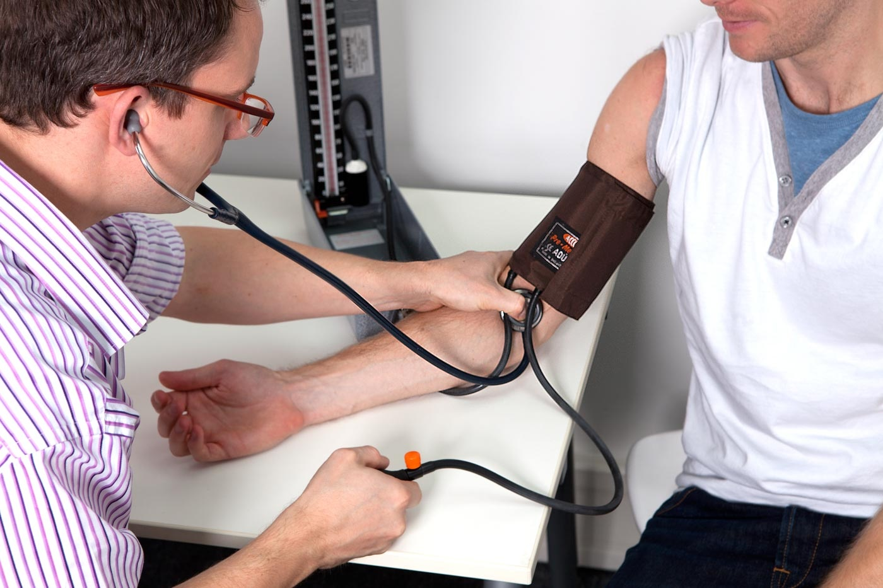
Came with 2 high readings and you want to confirm.
Two options
Ambulatory BP measurement.
Home BP monitoring.
Cuff size.
Twice daily measurement. (morning and evening).
Sitting position.
Two reading each time 1 min apart
4-7 days

Slide 38
Hyperlipidemia
ASCVD risk assessment :assign to statin group
use ASCVD calculator
assess other patient characteristics if they have any risk factor enhancer
Ask about life style
Ask about family history of hyperlipidemia
Share management
explain side effect of statin

Slide 39
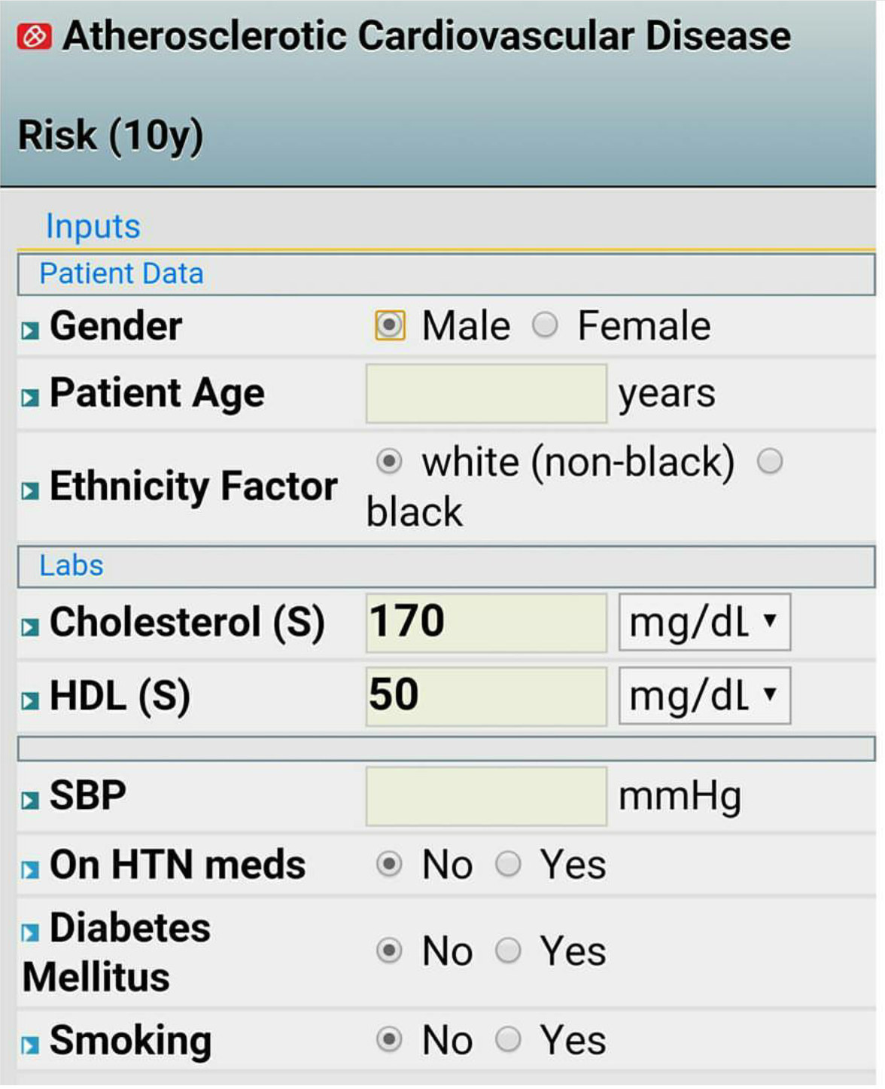

Slide 40
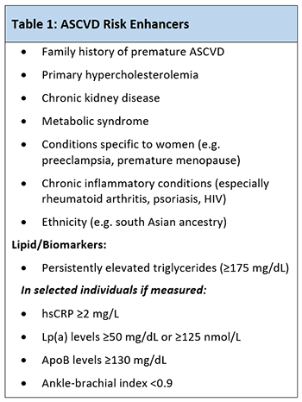

Slide 41
Management:
R reassurance:
A advice:
-Mediterranean diet, low fat, high fruits and vegetables, moderate chicken and fish, less meat
-active lifestyle, exercise.
-quit smoking and alcohol reduce (no more than 3-4 unit\day male and 2-3 unit\day female)
P prescription
According to the group

Slide 42
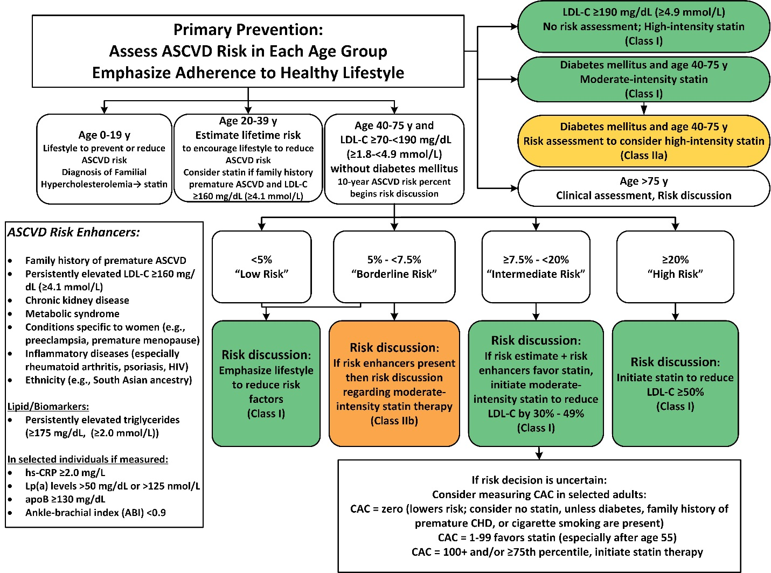

Slide 43
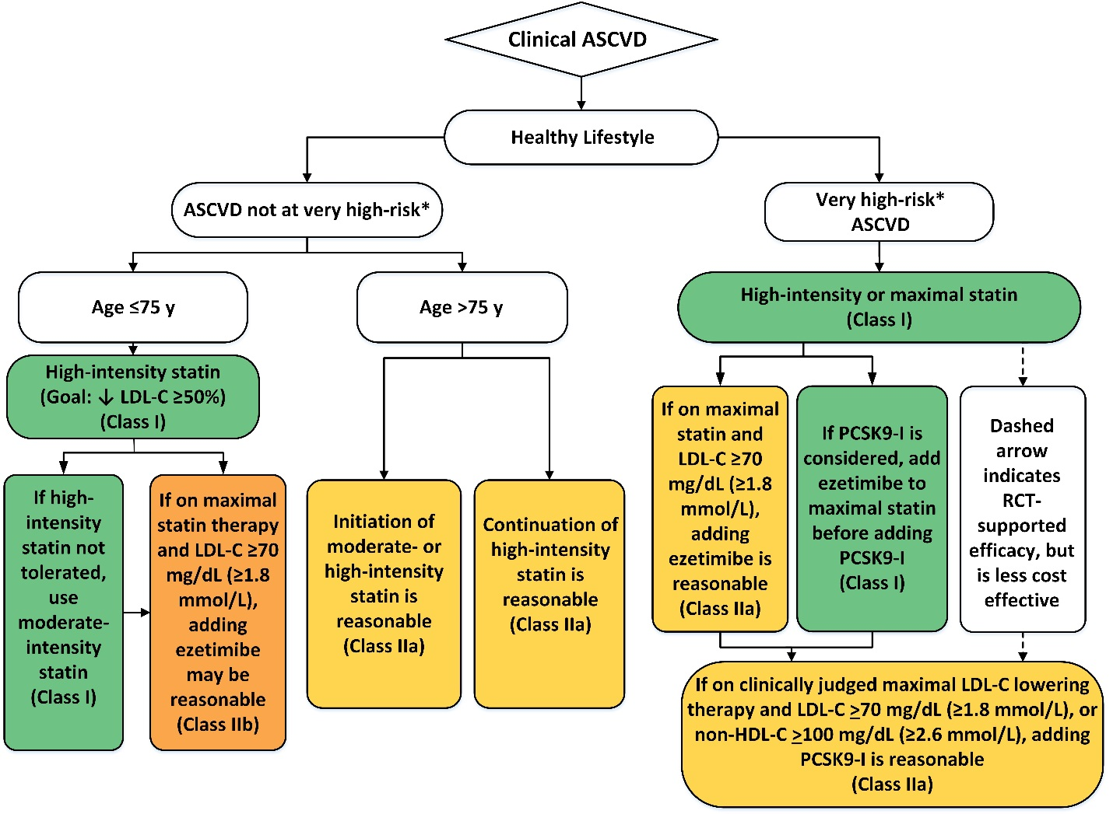
Secondary Prevention

Slide 44
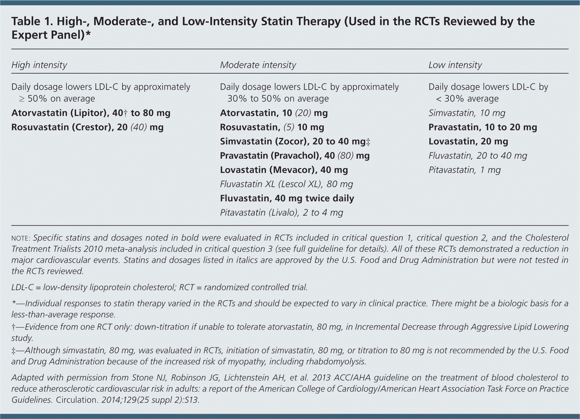

Slide 45
R referral to dietician.
I investigations
- Measure LDL at 4-12 week after the starting statin or dose adjustment
- Repeat every 3-12 months as needed
- check LFT at baseline then at 3 months then at 12 months
- Blood sugar and TFT
O follow up
-after 3 months
-treatment should be discontinued if serum transaminase concentration rise to and persist at 3X the upper limit of normal.

Slide 46
Normal and Abnormal Lipid Values in Childhood
 | Acceptable, mg/dL | Borderline, mg/dL | Abnormal, mg/dL
TC | <170 (<4.3 mmol) | 170-199 (4.3-5.1 mmol) | ≥200 (≥5.1 mmol)
Triglycerides (0-9 y) | <75 (<0.8 mmol) | 75-99 (0.8-1.1 mmol) | ≥100 (≥1.1 mmol)
Triglycerides (10-19 y) | <90 (<1.0 mmol) | 90-129 (1.0-1.5 mmol) | ≥130 (≥1.4 mmol)
HDL-C | >45 (>1.2 mmol) | 40-45 (1.0-1.2 mmol) | <40 (<1.0 mmol)
LDL-C | <110 (<2.8 mmol) | 110-129 (2.8-3.3 mmol) | ≥130 (≥3.4 mmol)
Non-HDL-C | <120 (<3.1 mmol) | 120-144 (3.1-3.7 mmol) | ≥145 (≥3.7 mmol)
Notes:
*Values for plasma lipid and lipoprotein levels are from the NCEP Expert Panel on Cholesterol Levels in Children. Non-HDL-C values from the Bogalusa Heart Study are equivalent to the NCEP Pediatric Panel cutpoints for LDL-C.
†The cutpoints for high and borderline high represent approximately the 95th and 75th percentiles, respectively. Low cutpoints for HDL-C represent approximately the 10th percentile.
Values given are in mg/dL. To convert to SI units, divide the results for TC, LDL-C, HDL-C, and non-HDL-C by 38.6; for triglycerides, divide by 88.6.
HDL-C indicates high-density lipoprotein cholesterol; LDL-C, low-density lipoprotein cholesterol; NCEP, National Cholesterol Education Program; SI, Système international d'unités (International System of Units); and TC, total cholesterol.

Slide 47
Respiratory system
1.Asthma (control)
2. COPD

Slide 48
CASE3 :
40yrs old Indian male came with dyspnea and cough x 2 day
On examination: wheezy chest.
Diagnosed as a acute exacerbation of bronchial asthma ,given treatment
Came to you the next day :
- from his file:
-k\c asthma came several time given flutiform inhaler.
-Came 3 time during the last 2month with same problem
How you mange this case?

Slide 49
Asthma
Similar to any chronic disease follow up should include asking about the 3 Cs
C Compliance
to prophylactic medication including the inhaler technique, dose, timing, duration, side effects e.g. oral thrush and halitosis
C Control- assess symptom during the last 4 /week
Activity limitation
night cough,
exercise induced cough,
need for reliever medications within a week,
need for oral or iv steroids,
modifiable risk factor(GERD, rhinitis, chronic rhinosinusitis, obesity and anxiety)

Slide 50
C Complication
hospital or ICU admission

Slide 51
If uncontrolled asthma, try to look for the cause
Wrong inhaler technique
Incompliance
Smoking
Beta-blockers
NSAIDs
Allergen exposure
Comorbidity (rhinitis, obesity, GERD, depression/anxiety).

Slide 52
Management :
R reassurance
A advice
- stop smoking and avoid passive smoking
-inhalation technique and compliance, exercise, avoidance of allergens.
P prescription
-step up or step down depending on the case (shared decision).
R referral
refer to specialist, if asthma still uncontrolled after 3-6 m on step 4 treatment.

Slide 53
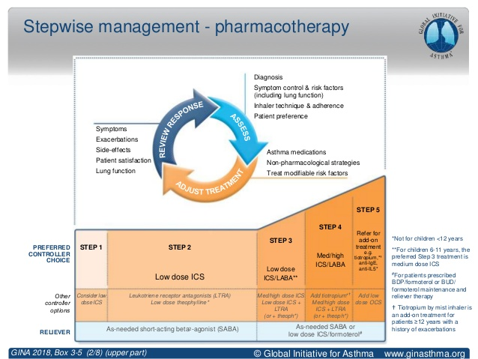

Slide 54
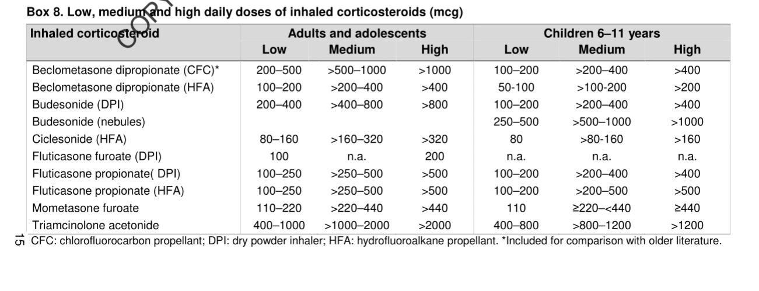

Slide 55
I investigation
CXR, peak flow with reversibility with b agonist ,spirometry and CBC
O observation
follow up after step up or down after 3 months, and give safety net.
P prevention
yearly influenza vaccine, and every 5 years pneumococcal vaccine.

Slide 56
Sleep apnea
Management:
R reassurance:
Explain the condition sleep apnea is condition whereby you have brief spell where your breathing stop when you are sleeping
A advice
loose weight ,stop smoking ,cut alcohol, avoid or cut down caffeine
and sleep position (1 thick or 2 thin pillows)
2. Ear plug for partner and avoid sedation
3. not drive if you feel sleepy

Slide 57
P prescription:
Beclomethasone nasal spray 2 puff bid or ipratropium bromide nasal spray 2 puff
R referral:
Respiratory : for sleep study and CPAP
ENT: e.g. enlarge tonsils ,polyps or septal straightening
I Investigation:
-TFT, Epworth Sleepiness Scale
- Sleep studies :diagnostic test

Slide 58
O observation:
-Open follow up
-Support for the patient and his partner

Slide 59
THANK YOU

